Slide 1

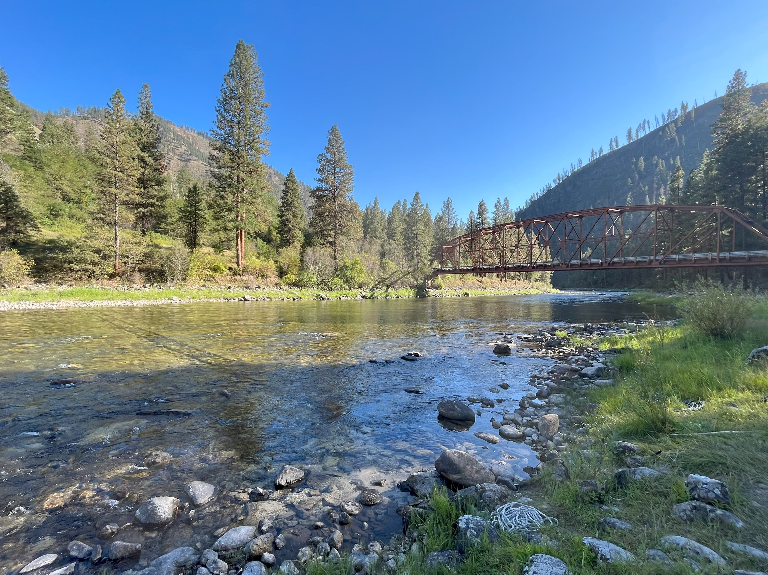
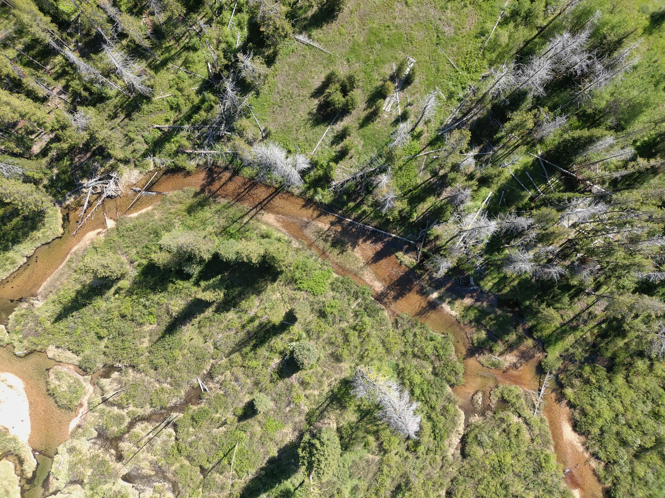

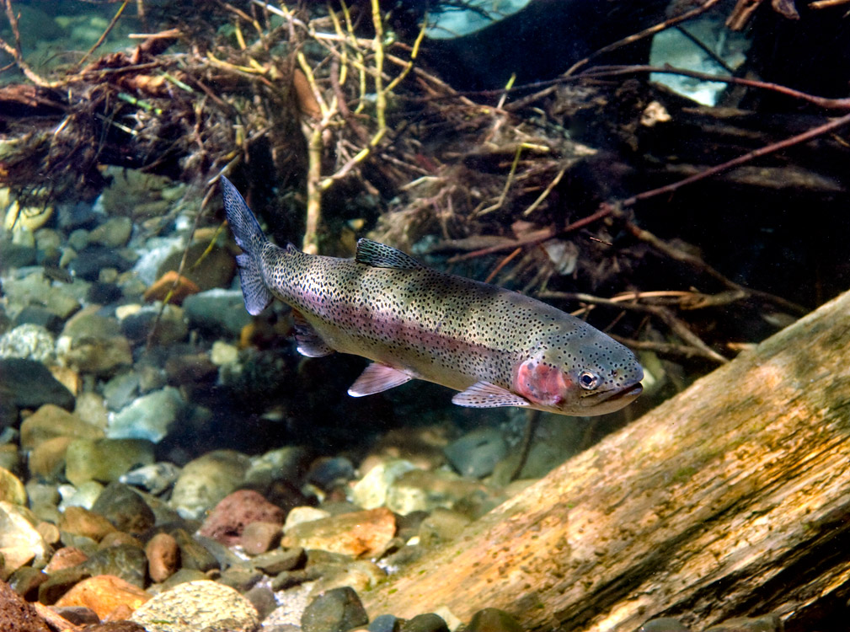
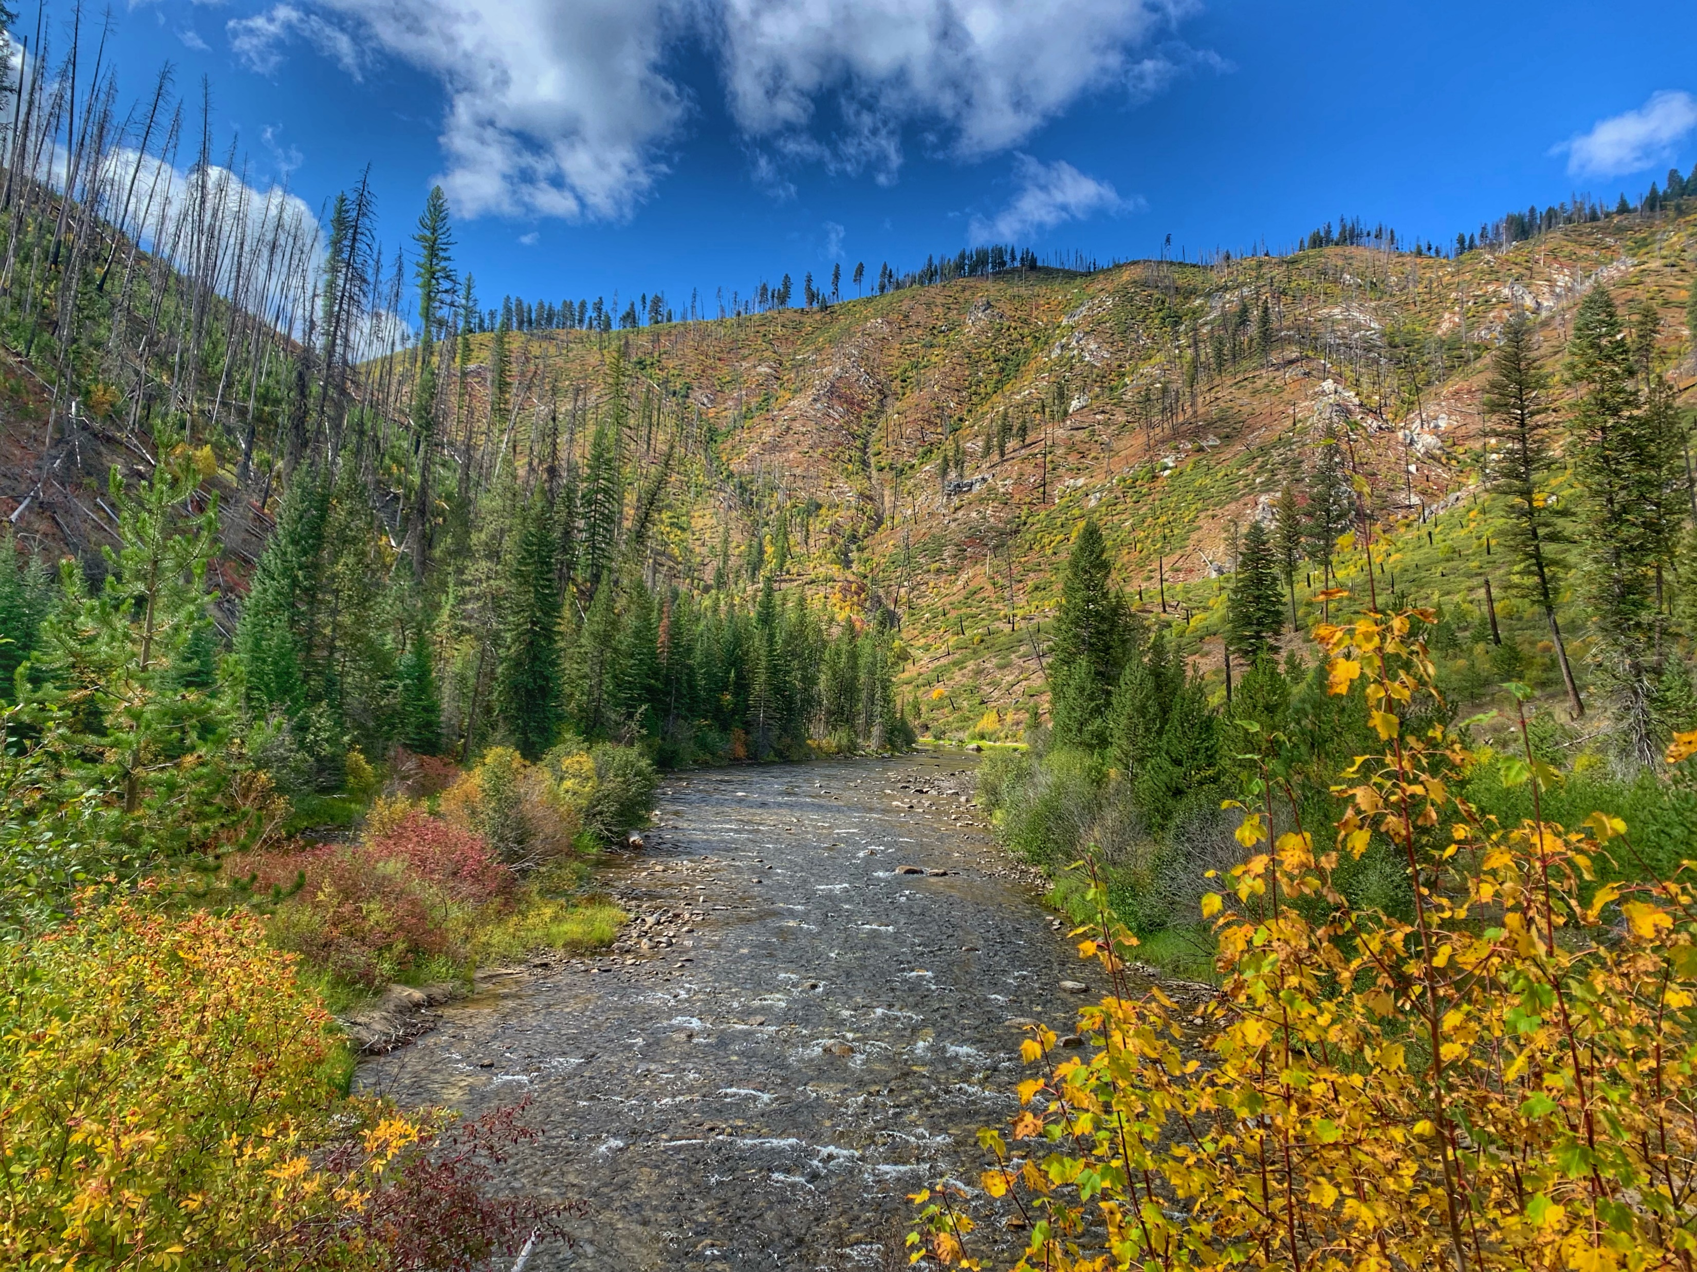
Evaluation of Steelhead Passage at the SF Clearwater River High-Velocity Reach, Draft
Mike Ackerman, Ryan Kinzer, Miranda Gordon, Peter Cleary
Clearwater Basin Coordination Meeting – June 6, 2024

Slide 2
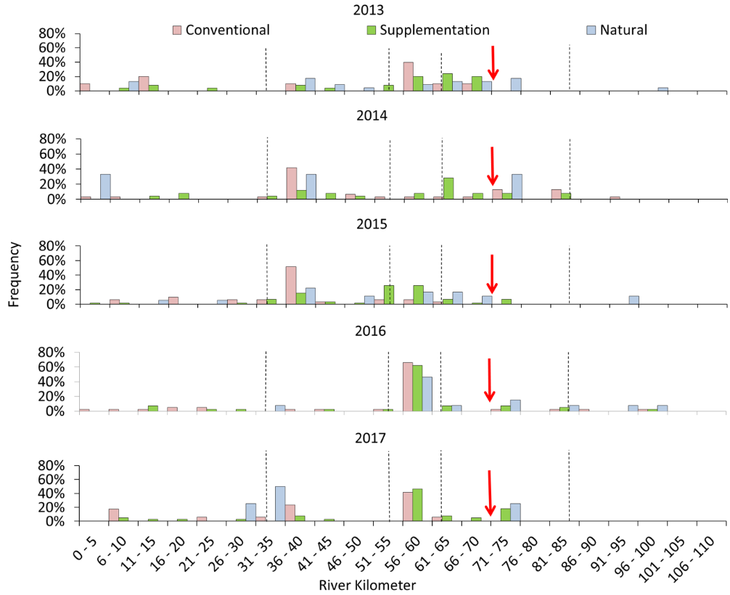
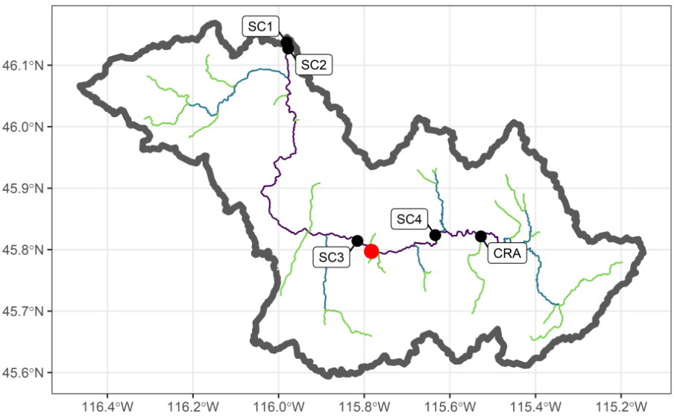
High-Velocity Reach
Background
River kilometer 71
Hypothesized as potential partial barrier to adult steelhead passage at higher flows
Few adult steelhead distributed to spawn above rkm 71 during a radio telemetry study, 2013 - 2017
Cleary (2019)
Notes:
Between 80 – 98% of spawners were last observed below the partial barrier in 2013 – 2017.

Slide 3
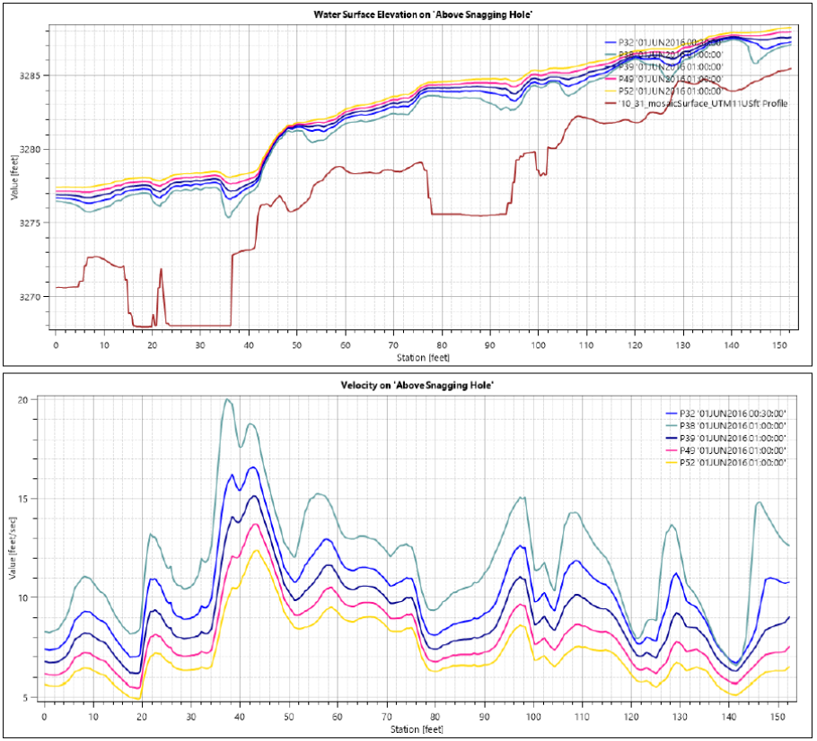
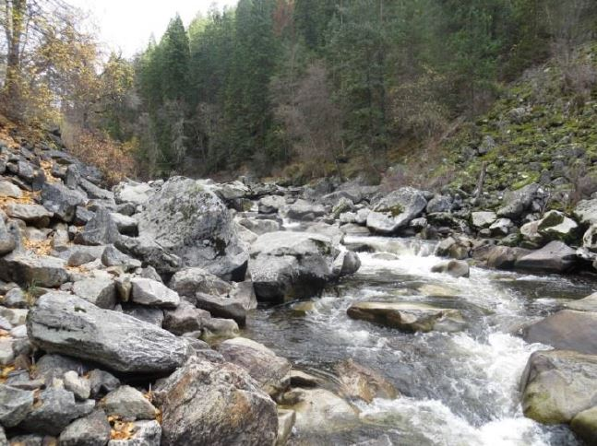
High-Velocity Reach
Background
As discharge exceeds 1,000 cfs, at least one velocity barrier emerges, exceeding burst swimming velocities for a 90 cm steelhead (Timms et al. 2017, 2018)

Slide 4
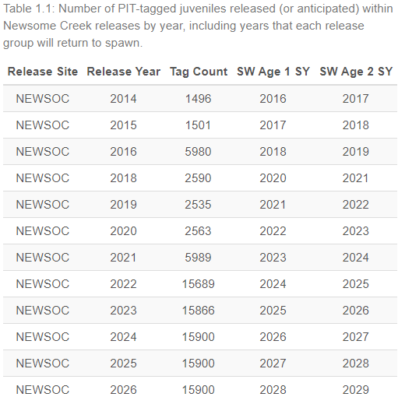
Evaluation
Methods
SC3 & SC4 installed August 2021
Number of PIT-tagged juveniles within Newsome Creek releases increased in 2022
1-ocean returns from 2022 releases started returning spring 2024
Queried DART for any adults later observed at any IPTDS within SF Clearwater
Spawn years 2022 – 2024
Evaluated conversion rates from SC3 -> SC4
Covariates: release location, discharge
Chinook salmon included for comparison

Slide 5
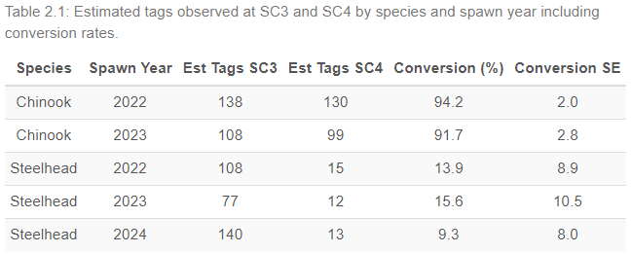
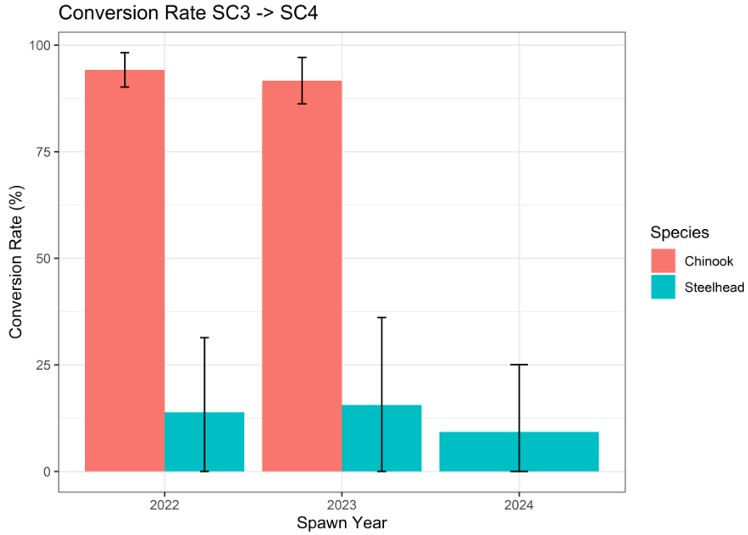
Conversion Rates
Results
Steelhead conversion rates substantially lower than Chinook salmon
Confounding factors:
Returning adult steelhead predominantly from downstream juvenile releases
Chinook salmon likely have higher propensity to migrate to upstream natal areas

Slide 6
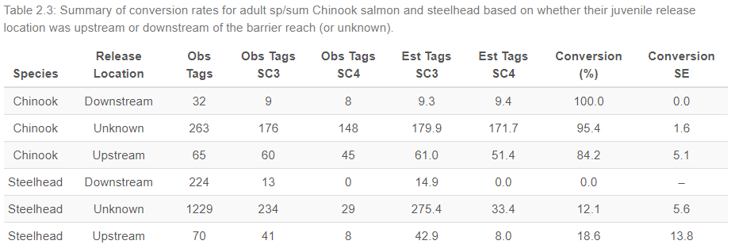
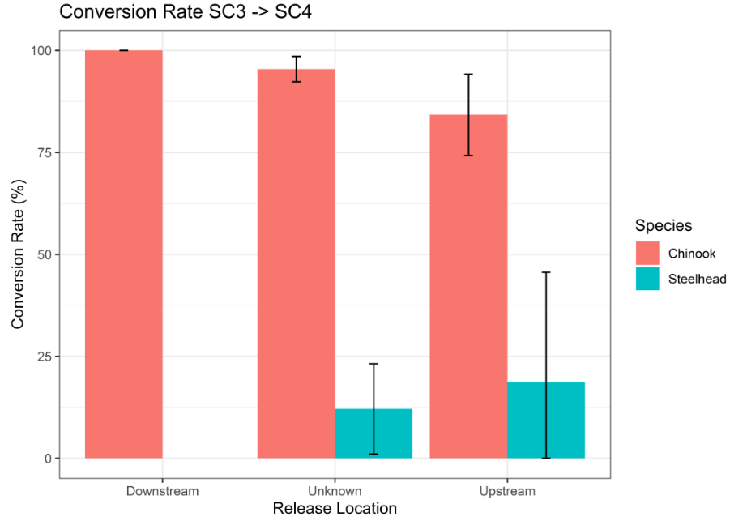
Release Location
Results
Years pooled due to lower sample sizes
Conversion rates for Newsome Creek releases higher (not significantly) than downstream releases
But still substantially lower than Chinook salmon

Slide 7
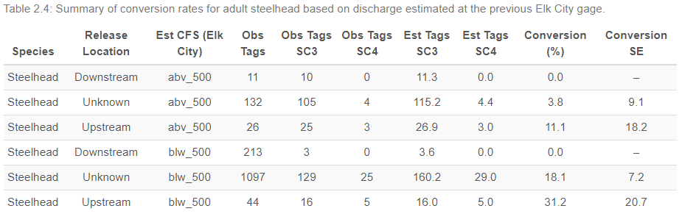
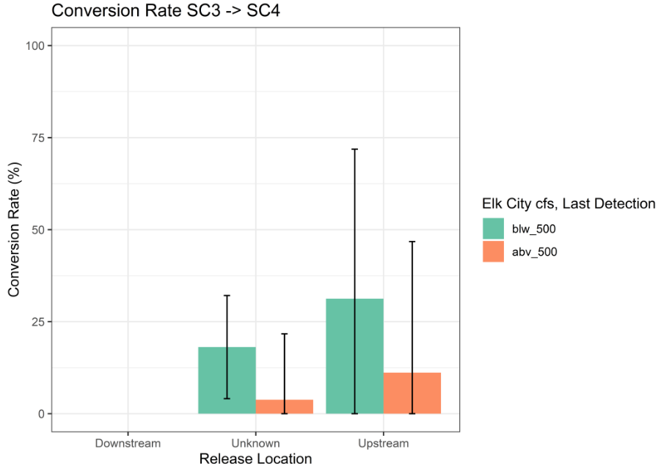
Discharge
Results
Steelhead only, years pooled
Conversion rates lower at flows > 1,000 cfs
Upstream releases only:
11.1% at flows > 1,000 cfs
31.2% at flows < 1,000 cfs

Slide 8
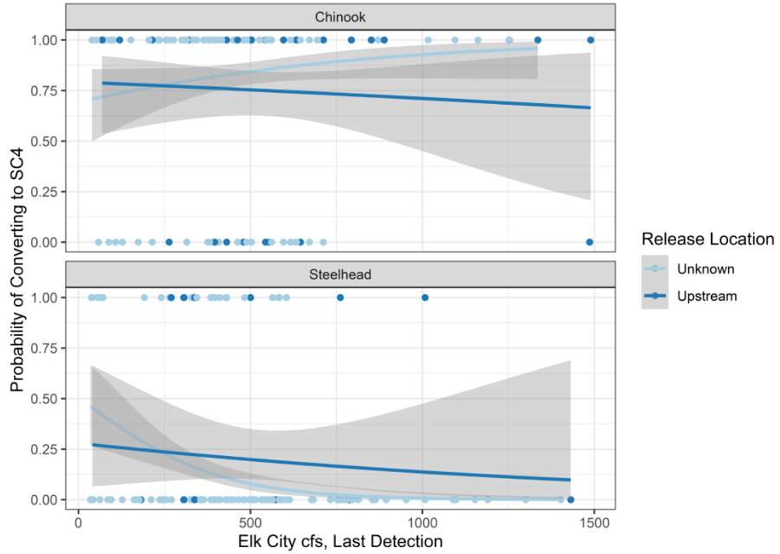
Logistic Regression
Results
Estimated probability of adult converting to SC4, given it arrived at SC3
Depending on:
Species
Release Location
Estimated Flow at Elk City
Estimated downward trend in probability of adult steelhead converting to SC4 at higher flows
~ 25% at 250 cfs (500 at reach)
~ 20% at 500 cfs (1,000 at reach)
Low sample sizes at some flows i.e., large standard errors

Slide 9
Preliminary Conclusions
Discussion
Adult steelhead conversion rates SC3 -> SC4 are low
However, unknown why conversion rates are substantially lower than for Chinook salmon at similar flows
Body size differences?
Swimming capabilities?
Propensity to migrate upstream?
Baseline monitoring established to evaluate effects of any actions to alleviate high-velocity issues
E.g., Before-after logistic regression. Does slope or relationship change post-action?
Evaluation will be updated annually after each steelhead run, supported by increased Newsome Creek releases
Increased sample size will improve precision and ongoing monitoring

Slide 10

mikea@nezperce.org
https://github.com/NPTfisheries
https://github.com/mackerman44
www.nezperce.org
O: 208-634-5290 x3302
C: 208-469-0896

Slide 11
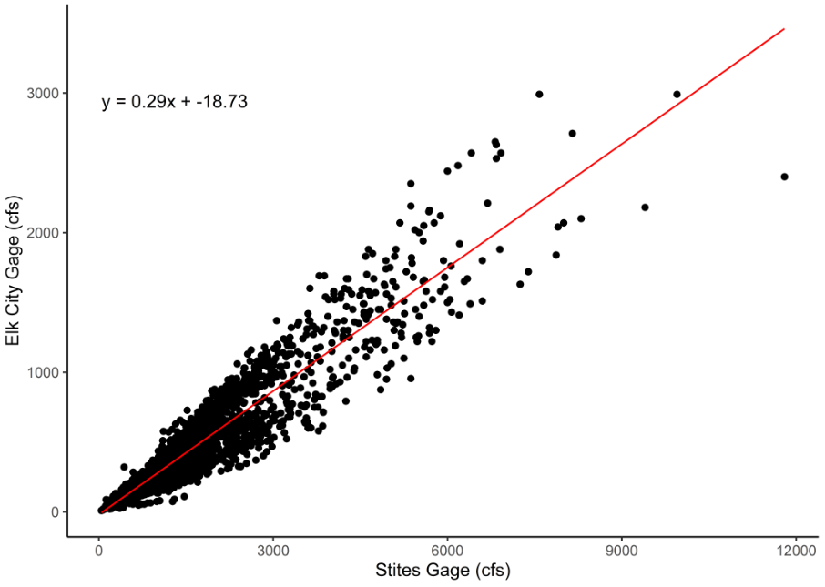
Elk City vs. Stites Linear Regression

Slide 12
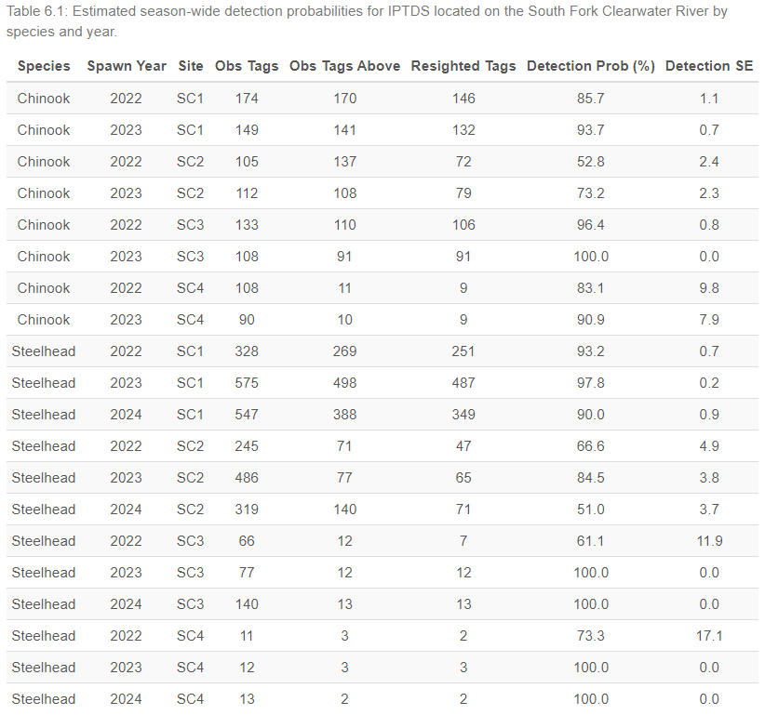
IPTDS Detection Probabilities

Slide 13
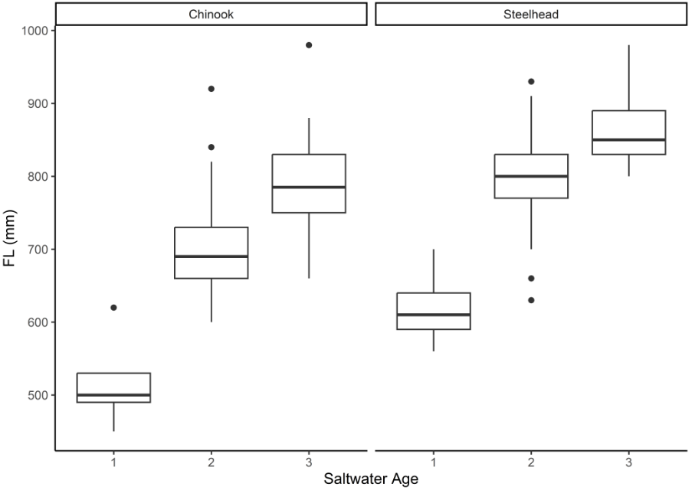
Length at Saltwater Age

